Slide 1
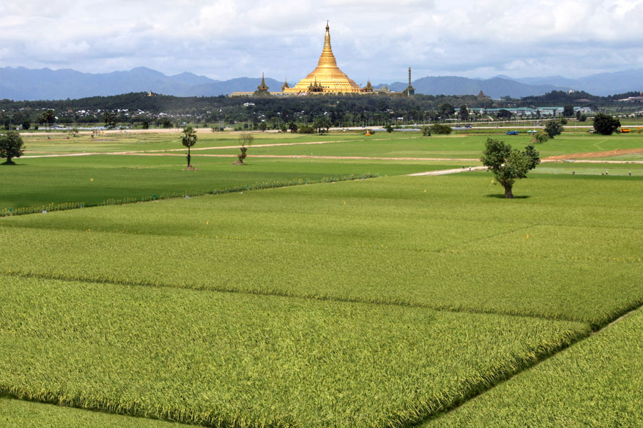
Ministry of Agriculture and irrigation
Department of Agriculture
Support of Agriculture-related Laws for Seed Industry Development & Private Sector Participation on Myanmar Rice Production
Dr. Ye Tint Tun
Director General
Department of Agriculture
18 March, 2016

Slide 2
Introduction
Why Rice Demand is Growing
World population will increase 9 Billion by 2050
Rice demand in traditional rice growing countries will continue to rise until they graduate to middle income country
China's rice import may rise to 5-6 million tons in 2020
In China, 14 million tons goes for feed and 8 million tons for industrial use
India's rice production would reach at the levels of 108 million tons by 2020 against its requirements of 118 million tons
The demand for rice in Africa continues to increase, with an annual average importation of 2 million metric tons to fill the gap of production

Slide 3
Global Rice Consumption is Speed up

Slide 4
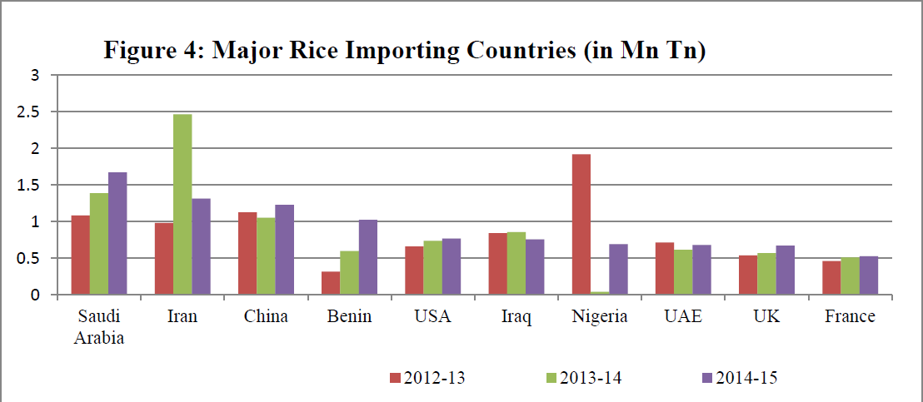
Major Rice Importing Countries
Mil Ton
Source: Comtrade
Saudi Arabia was the leading importer in 2014-15 followed by Iran and China

Slide 5
Different Type of Rice Cultivation in Myanmar
Monsoon Rice
Summer Rice

Slide 6
Harvested Area and production of Rice in Myanmar
Total Rice Production
Hybrid Seed Production
F1 Seed Production

Slide 7
Quality Seed Demand and Supply in Myanmar
Seed Demand
Can provide only 25.72% of Demand
(Ton)
RS Production
CS Production

Slide 8
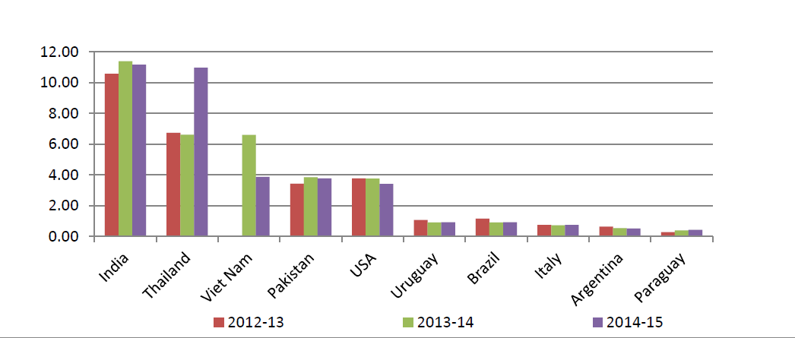
Major Rice Exporting Countries
Mil Ton
Myanmar
Source : Comtrade
India was the largest exporter of rice in 2014-15 followed by Thailand and Vietnam and Pakistan

Slide 9
Efforts on Seed Industry Development
Farmers
Direct profit
Seed Policy
Seed Law
Plant Varietal Protection law
The Law of Protection of the farmer Rights and Enhancement of their Benefits
Support
Fertilizer Law
Plant Pest Quarantine Law
Pesticide Law
Farmland Law
Virgin land law
Policy
Collaboration
Laws
Regulations
Public
Private
Seed is the vital and fundamental food source for human being

Slide 10
Myanmar’s Existing Laws and profit to private Sector
Seed Policy
To support the establishment of sustainable seed industry through systematic and strategic approaches
Strategies:
Encourage the private sector, to progressively expand its activities in certified seed production and marketing of the major crops, especially rice. (strategy _3)
Support elevating private sector capacity in both research and foundation seed production at an acceptable level. (strategy_ 4)
Undertake all steps and policy measures to gradually reduce the role of the public sector that the private seed sector would eventually dominate all aspects of the seed sector which lend themselves to commercial operations. (strategy_ 5)

Slide 11
Seed Policy
Seed production
The private sector will be free to produce FS from their own BS in line with the provisions of the Seed Law. (Sect 7 a, b)
Seed conditioning and storage
Service the spare capacity of existing seed plants to emerging private sector and encourage them to invest in this area to meet their own specific needs (Sect 8)
Seed Market, Distribution and Export
Government will assist the private sector for marketing and data source on seed demand, agro-ecological, needed facilities and other inputs (Sect_10-b, c)
Farmers affected under emergency situations have to be assisted by Government (Sect_10-d)
Government will support any private sector initiative that seeks to exploit the seed export potential. (Sect_12)
Seed Sector Development
provision of low-interest credit to establish seed processing facilities, reduced taxes on imported seed processing and handling machineries and equipment (Sect-13)
Government will undertake appropriate measures to ensure that farmers get reasonable returns when they sell their produce. (Sect-13)

Slide 12
Seed Laws & Related Laws in Myanmar
No. | Title of Law or Regulation | Scope of Law or Regulation | Responsible Agency | Status
1. | The Seed Law | To maintain quality and the use of seeds | MOAI | Enacted 2011
2. | Plant Varietal protection Law | Intellectual property right of breeder | MOAI | Enacted 2016
3. | The Law of Protection of the farmer Rights and Enhancement of their Benefits | To protect the farmers’ right | MOAI | Enacted 2013
4. | Farmland Law | Right to use the Farmland | MOAI | Enacted 2012
5. | Vacant, Fallow and Virgin Land Management Law | Right to Cultivate or Utilize Vacant, Fallow and Virgin Lands | MOAI | Enacted 2012
6. | Fertilizer Law | To manage the use of fertilizer | MOAI | Enacted 2002
7. | Pesticide Law | Covers the use of pesticides | MOAI | Enacted 1990
8. | Plant Pest Quarantine Law | To Prevent quarantine pests from entering into Myanmar | MOAI | Enacted 1993

Slide 13
Seed Law
Enacted 2011, Amended 2015
Four objectives, one of them: Encourage for enabling the participation in seed production and carrying out seed research by individuals/private (sect 3-c)
Formation of the National Seed Committee
Experts and suitable persons are welcome as members of NSC (sect 4-a)
Functions and Duties
One of the duty and function of NSC is to carry out for the development of seed research works of organizations and individuals/private (sect 5-c)
Cooperating with the Government and organizations, international organizations and individuals relating to seed business (sect 5-f)
Quality Control
Any person desirous of establishing the Seed Testing Laboratory shall apply to NSC (sect-12)
Seed Business
A person desirous of carrying out the seed business shall apply to TSC to obtain a license in accord with stipulations (sect 16-a)

Slide 14
Protection of New Plant Varieties Law
Enacted 2016
Four Objectives, two of them:
To protect new plant breeder right (sect 3-a)
To increase both local and foreign investment in breeding for new plant (sect 3-c)
Application for Protection of the Breeder Right
The citizens, the foreigners and organizations (permanent resident in Myanmar), individuals and organizations from foreign countries (agreement for protection of the new plant variety) shall be allowed to make application for the right to protect of new plant variety (sect 15-a, b, c)
Conditions to Protect the Right
Plant breeder may have the right to acquire the plant parts to be harvested or whole of the harvested plant for doing matters if any person use the propagated parts of the protected plant variety without permission (sect 25)

Slide 15
The Law of Protection of the Farmer Rights and Enhancement of Their Benefits
Enacted 2013
Duties and functions
Assisting farmers to produce and sell profitable crops freely (sect 5-a)
Educating the right choice of cropping pattern conformity with the region (sect 5-b)
Arranging loan and assistance for the farmer when it is required for agricultural production (sect 5-c)
Assisting to sell agricultural produces freely within the country and to export them legally (sect 5-d)
Supporting modern technology and inputs for the development of agriculture and livestock breeding establishment and encouragement of research (sect 5-e)
encourage development of standard private seed research works and private seed production (Sect 20-a)
Linking with he market to get reasonable prices for agricultural produces of farmers. (sect 5-f)
Coordinate with international organizations and regional organizations of each category of agricultural produce. (sect 5-g)
connect with organizations for dissemination of market and price information to get local and foreign market (Sect 20-d)

Slide 16
Farmland Law
Enacted 2012
Issue the certificate to use the farmland
Person or organization after registration by paying registration fees in accord with the stipulations (sect 6)
Right to use the farmland law
Right to have the farmland in possession, right to use the farmland, right to enjoy the benefit arises from this right; (sect 9-a)
Right to use common interest with investment
By cooperating with private investors, village co-operative, foreigner or organization for development of agriculture in the farmland (sect 9-e & f)
Confirming after scrutinizing the submission
To use the farmland in constructing rice-mills, storehouses of crops etc., in changing over the system of manual to mechanized agriculture for the development of the agricultural sector; (sect 17-g)
Application to alter originally cultivated crops to others:
Permit to cultivate other crops in low land (paddy land) after scrutinizing in accord with the stipulations so as not to affect the sufficiency of rice which is the staple crop of the State and it is alter crops except low land as well (sect 28-a)
Vacant, fallow and virgin lands
The cultivation and production of crops is stable, alter and stipulate as the farmland and cause to involve in this Law (sect 34)

Slide 17
The Vacant, Fallow and Virgin Lands
Management Law
Enacted 2012
Right to Cultivate or Utilize Vacant, Fallow and Virgin Lands by the following persons:
Myanmar citizen investors;
investors, who obtained the permission to carry out the businesses of mutual benefit with any Government department or organization under the Foreign Investment Law;
investors who obtained the permission to carry out the businesses of mutual benefit with investors of Myanmar citizen under the Foreign Investment Law.
Stipulations Relating to the Right to Cultivate or Utilize Vacant, Fallow and Virgin Lands
perennial plant and industrial seasonal crops, permit 5000 acres at a time. If 75 percent have been fully carried out, permit again not exceeding 5000 acres up to the total of 50000 acres time after time. If the business which should be permissible for the interest of the State, permit more than 5000 acres at a time with the approval of the Union Government.
orchard, permit not exceeding 3000 acres.
permit not exceeding 50 acres of vacant, fallow and virgin land for the rural cultivators and persons desirous of carrying out agriculture on manageable family-sized scale.

Slide 18
Myanmar’s Existing Laws and profit to private Sector
Fertilizer law
registration certificate for fertilizer production, importing or exporting as commercial purposes.
allow compounding, mixing, repackaging, storing or distribution and sale of fertilizer as commercial purposes.
Chance to get suitable experts to lay down the policy and guidance relating to the fertilizer business
Pesticide law
According to protect our surrounding pollution and prevent consumer and user health damage cause of agro-chemicals
Any person desirous of importing formulated pesticides and active ingredients or export of the same must have one of the following registration/ use permit. An application in the prescribed form shall be submitted to the Registration Board. (Chapter 4.13)
(a) experimental registration;
(b) provisional registration;
(c) full registration;
(d) special use permit;
Allow the application for License; (Chapter 5.17)
pesticides formulation and sales in the country from imported active ingredients .
re-packing and sale of imported pesticides, within the country.
Fumigation License for export commodities , stored plants products, warehouse, buildings , containers and vehicle.
Plant Pest Quarantine law
To prevent quarantine pests from entering into Myanmar by any means.(Chapter 2.3(a))
To issue phytosanitary certificate for plant and plant product to be exported and import certificate for plant and plant product to be imported (Chapter 2.3(b))

Slide 19
International Cooperation for Seed Development Projects
No. | Project Name | Year | Provided Organization
1. | Seed Development Project Phase I | 1978-1984 | World Bank
2. | Seed Development Project Phase II | 1986-1994 | World Bank
3. | Support to Special Rice production | 2009-2012 | FAO
4. | Development of Participatory Multiplication and Distribution System for Quality Rice Seed | 2011-2016 | JICA
5. | Diversification and Intensification of Rice-based Cropping System in Lower Myanmar (My Rice) | 2012-2015 | IRRI, ACIAR
6. | Support to the Development of Hybrid rice in Myanmar | 2013-2015 | FAO
7. | International Fund for Agriculture Development, FARM Project | 2014-2020 | IFAD
8. | Agricultural Development Support Project | 2016-2021 | World Bank

Slide 20
Current Collaborative Private Companies
New Aye Yar Co.ltd
Great Wall Co.ltd
Shwe Nagar Min Co.ltd
Nine Sea Co.ltd
Yu Za Na Co.ltd
Dagon International Co.ltd
Zeyar Premiere Co.ltd
Green Asia Co.ltd

Slide 21
Challenges to Minimize Gap
Poor collaboration and information sharing
Low trusty between departments, private, organization and farmers
Lagged of technology and human resource development
Low infrastructures Development
Physical & Technical
Low interest to investment

Slide 22
Improve Collaboration and Trust to lay down the platform for Seed Association network
Get Assistant from International and National Partners for HRD
Raise Awareness for policy and laws
More privatization on technology
Establishment of Micro finance system for quality seed production
Set up the model station with contract farming for C.S production
Set the guarantee price for seed market
Distribute the seeds to farmers with reasonable price
Piling the revolving fund to keep the quality seed as reserved if emergency
Win-Win Situation to all involvements.
Way Forward

Slide 23
Conclusion
Myanmar needs to open up for private sector involvement in Agriculture sector.
National and International partners should invest the Agriculture sector as long term project.
Private sector should look at win-win situation in Agriculture sector.
Participation of farmers and their awareness is very important and urgently need to improve.
The policy, law and regulation should be flexible and easy to amend with situation.
Also should be uniform with international standard.
Government sector implementing alone is heavy load for many seed class production and planning hand over to private sector.
Technology and human resource is available but need to upgrade with international standard.

Slide 24
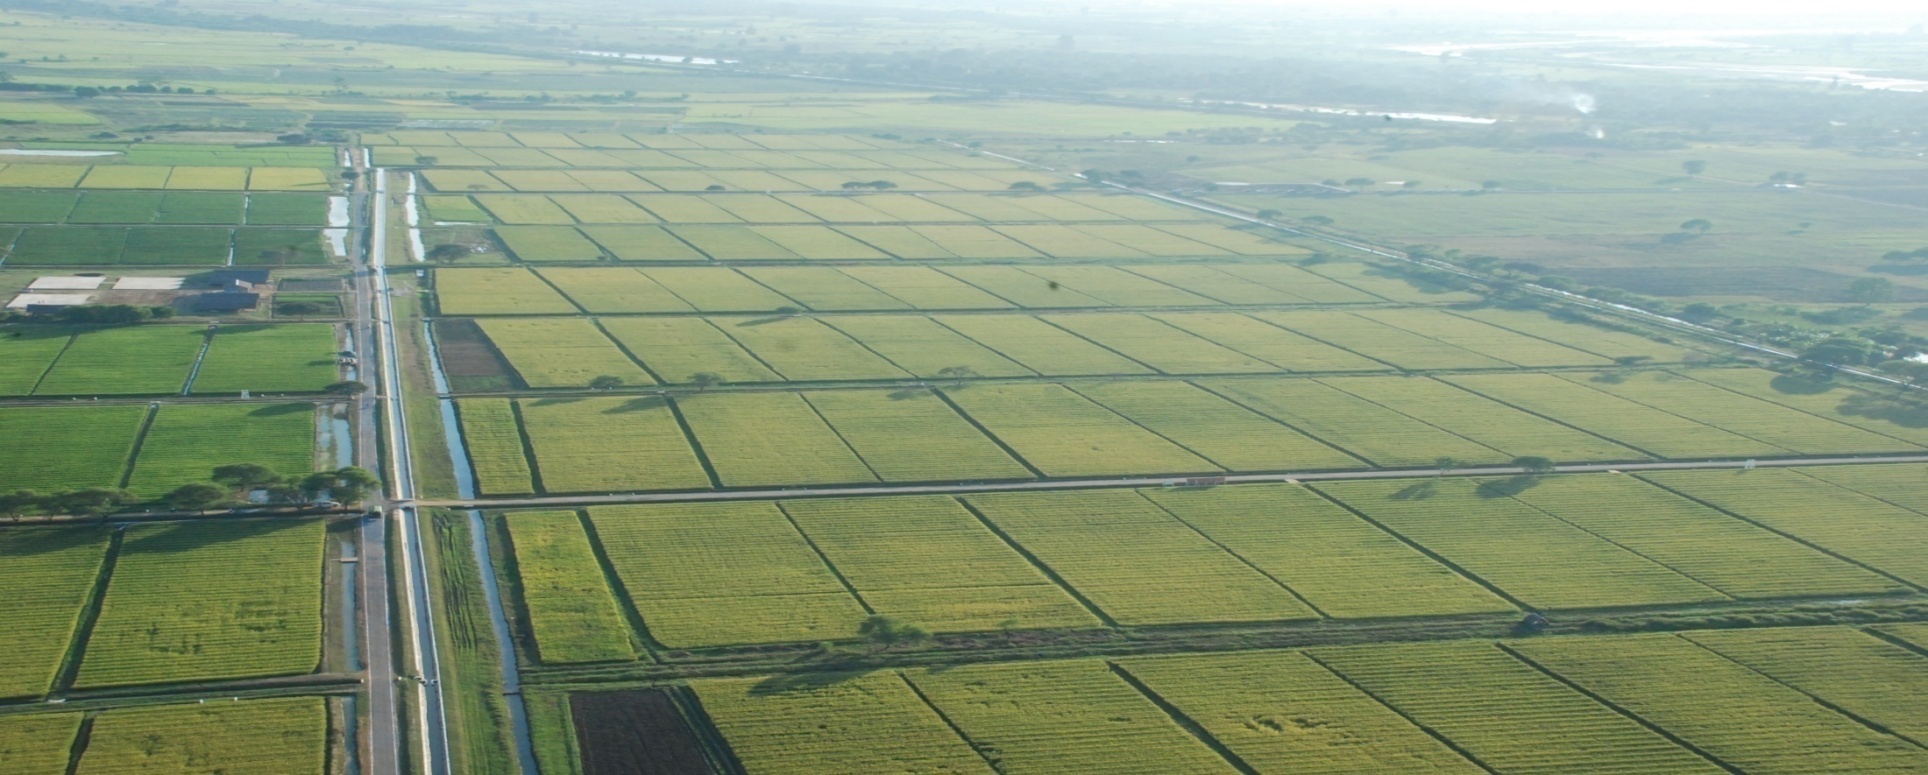
Thank you for your kind Attention

